Slide 1
SQL DML: Data Manipulation Language
F28DM Database Management Systems
Phil Bartie
Based on material from
Alasdair Gray
Monica Farrow
Notes:
Dual projection lecture using SQL script to show queries over database
-- WINDOW functios
--COMMON TABLE EXPRESSION
Lecture likely to take more than one session
SHOW VIDEO https://www.youtube.com/watch?v=mgipNdAgQ3o

Slide 2

Materials released under CC-BY License
You are free to:
Share — copy and redistribute the material in any medium or format
Adapt — remix, transform, and build upon the material for any purpose, even commercially.
The licensor cannot revoke these freedoms as long as you follow the license terms.
Under the following terms:
Attribution — You must give appropriate credit, provide a link to the license, and indicate if changes were made. You may do so in any reasonable manner, but not in any way that suggests the licensor endorses you or your use.

Slide 3
Topics in this Lecture
Single table queries
SELECT-PROJECT-JOIN queries
Set operations
Nested queries
NOT IN
NOT EXISTS
Aggregate functions
GROUP BY
HAVING

Slide 4
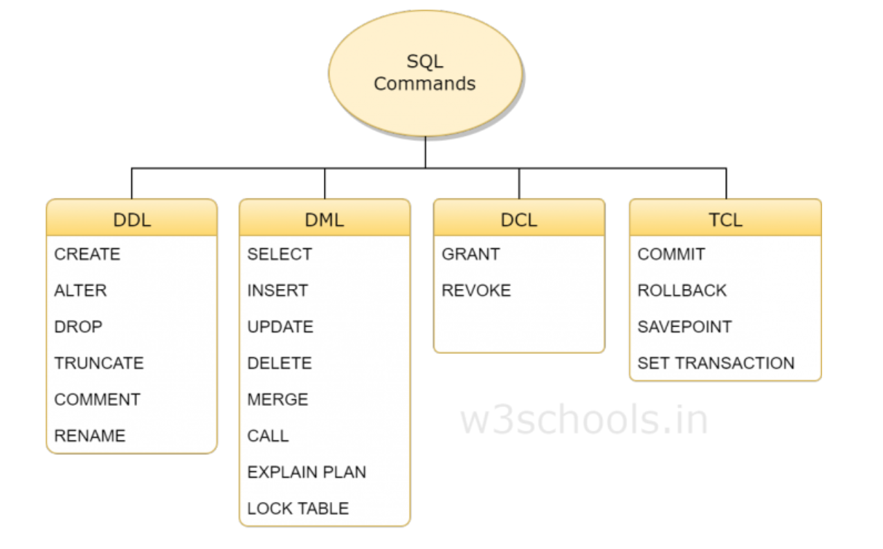
SQL: RECAP
Notes:
SQL Consists of 4 sub-languages
DDL – Data Definition Language
DML – Data Manipulation Language
DCL – Data Control Language
TCL – Transaction Control Language

Slide 5
SQL SELECT STATEMENT SYNTAX
SELECT {field1,field2,… * for all fields}
FROM {table}
WHERE {condition}
GROUP BY {field1, field2,…}
HAVING {condition}
ORDER BY {field1,field2,…} {ASC or DESC}
LIMIT {n};
The first { } can be replaced with * which means return all of the fields in the table
WHERE condition is optional – if not used all results will be returned
GROUP BY is optional – aggregates data & therefore restricts the fields which can be returned
HAVING is optional after using GROUP BY – it’s like a WHERE condition acting on the GROUP BY results
ORDER BY is optional and can be ASC or DESC for ascending or Descending order
LIMIT is optional and can be used to returning a few records not the entire table
Commands can be written on a single line or spread over many lines
Field and Table names must be in lowercase
Command should end with a semi-colon ;
Comments are not parsed, but useful for keeping notes and are marked with double hypen --

Slide 6
Company Database
DBEmployee
ssn | lastname | firstnames | dateOfBirth | gen der | salary | emp dNum | supssn
123 | Smith | Gordon | 12/02/1953 | M | 25000 | 1 | 124
122 | Brown | Fiona | 24/05/1980 | F | 30000 | 1 | 123
124 | Johnson | Keith | 01/07/1974 | M | 28000 | 2
DBDepartment
DBProject
dNum | dName | mgrSsn | mgrStartDate
1 | HR | 124 | 12/02/1999
2 | Computing | 123 | 14/03/2001
pNum | pName | pdNum
3 | Jupiter | 3
4 | Mars | 3
5 | Uranus | 3
DBLocation
DBDeadline
DBWorksOn
ldNum | loc
1 | Hillhead
1 | Overton
2 | Overton
dLinepNum | dLineDate | dLineType
123 | 01/04/2013 | Final
124 | 01/02/2013 | Intermediate
wssn | wpNum | hours
123 | 3 | 5
123 | 4 | 20
122 | 4 | 10

Slide 7
SELECT-PROJECT SQL query
Query structure
SELECT list of attributes FROM list of tables WHERE condition;
http://dev.mysql.com/doc/ refman/5.6/en/select.html
Comma separated list of attributes
Comma separated list of tables
Example
Return the names and date of birth of female employees
SELECT firstnames, lastname, dateOfBirth FROM DBEmployee WHERE gender = 'F';
Notes
Explain query in English first
Indenting to ease reading
Single quote for string condition

Slide 8
SELECT-PROJECT Query Answer
SELECT firstnames, lastname, dateOfBirth FROM DBEmployee WHERE gender = 'F';
Results will be the highlighted cells, arranged in the order given in the SELECT line
DBEmployee
ssn | lastname | firstnames | dateOf Birth | gender
123 | Smith | Gordon | 12/02/1953 | M
126 | Fraser | Jane | 24/05/1980 | F
127 | Gordon | Mary | 01/04/1977 | F
125 | Johnson | Keith | 01/07/1974 | M

Slide 9
More Querying Basics
Omit unused clauses: e.g. no WHERE clause
SELECT firstnames, lastName, dateofBirth FROM DBEmployee;
We can retrieve all the columns by use of *
SELECT * FROM DBEmployee WHERE gender = 'F';
Use AND, OR, brackets etc for multiple conditions
SELECT * FROM DBEmployee WHERE gender = 'M' AND lastname = 'Johnson';

Slide 10
Expression conditions
Equality =
lastName = 'Smith'
dNum = 2
Strict string equality: 'Smith' is not the same as 'Smith '
Not equal <> ( sometimes != )
firstName <> 'Fraser’
firstName != 'Fraser’
Less than <
salary < 30000
Less than or equal <=
Greater than >
salary > age * 1000
Great than or equal >=

Slide 11
Logical connections: AND, OR, NOT
Expressions can be connected together
Parenthesis used to override binding
NOT binds more strongly than AND
AND binds more strongly than OR
What is the difference in the following queries?
SELECT firstName, lastName, empdNum FROM DBEmployee WHERE gender = 'M' AND empdNum = 1 OR empdNum = 2;
(14 rows)
SELECT firstName, lastName, empdNum FROM DBEmployee WHERE gender = 'M' AND NOT empdNum = 1 OR empdNum = 2;
(19 rows)
SELECT firstName, lastName, empdNum FROM DBEmployee WHERE gender = 'M' AND NOT (empdNum = 1 OR empdNum = 2);
(11 rows)
Notes:
Male employees in dept 1 or 2
Male employees in dept 2 or not in dept 1
Male employees not in dept1 or dept 2

Slide 12
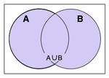
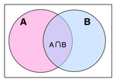
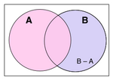
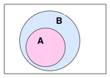
Logical Conditions
Union
(OR)
Intersection
(AND)
Based on
SET THEORY
Difference
(B is true NOT also in A)
A is a subset of B

Slide 13
Example
Set of integer values from 1 to 9 (inclusive) Set A = integer result when divided by 2 Set B = integer result when divided by 3
A
B
U is {1,2,3,4,5,6,7,8,9}
4
6
3
2
A is {2,4,6,8}
8
9
B is {3,6,9}
5
1
7
Intersection (AND)
A ∩ B
= {6}
Union (OR)
A ∪ B
= {2,3,4,6,8,9}
Not in
A \ B
= {2,4,8}
Notes:
SET A AND SET B =6
SET A OR SET B = 2,3,4,6,8,9
SET A NOT IN SET B = 2,4,8

Slide 14
--This will return all of the fields (as it uses * to mean get all fields from the table)
SELECT * FROM test_table1 WHERE x = 100;
--This will return only the id and y fields
SELECT id,y FROM test_table1 WHERE x = 100;
--Reduces the returned records as the where condition is more restrictive (AND)
SELECT * FROM test_table1 WHERE x = 100 AND id = 1
--Increases the returned records as the where condition is less restrictive (OR)
SELECT * FROM test_table1 WHERE x = 100 OR id = 2;
--Use parenthesis to generate more complex queries
SELECT * FROM test_table1 WHERE (x = 100 AND y = 234) OR (id=2)
--using IN to check against list of supplied values
SELECT * FROM test_table1 WHERE x in (1,3,5,7,11,13);

Slide 15
Ordering Results
Results returned in arbitrary order by default
ORDER BY clause allows user control
Increases query time as results must be sorted
Example
List employees details by decreasing salary and then alphabetically on surname
SELECT * FROM DBEmployee ORDER BY salary DESC, lastname ASC;

Slide 16
Duplicate Removal
Database does not contain duplicates: Entity constraint
SELECT clauses without primary key results in duplicates
Eliminate duplicates using DISTINCT
Requires post result processing
Example
Return employee genders
SELECT gender FROM DBEmployee;
Answer per employee
Example
Return employee genders
SELECT DISTINCT gender FROM DBEmployee;
2 answers

Slide 17
Ranges and Value Sets
Range
Set
Employee names for employees in departments 1 to 3
SELECT firstnames, lastname FROM DBEmployee WHERE empdNum >= 1 AND empdNum < 3;
Employee names for employees in departments 1 to 3 (inclusive)
SELECT firstnames, lastname FROM DBEmployee WHERE empdNum BETWEEN 1 AND 3;
Employee names for employees in departments 1, 3, and 5
SELECT firstnames, lastname FROM DBEmployee WHERE empdNum = 1 OR empdNum = 3 OR empdNum = 5;
Alternatively:
SELECT firstnames, lastname FROM DBEmployee WHERE empdNum IN (1,3,5);
Notes:
Are the range queries equivalent? No!

Slide 18
Searching for Nulls
Nulls are not values: they are placeholders
Example
Names of employees with a supervisor
SELECT firstnames, lastname FROM DBEmployee WHERE supssn = Null;
Correct form:
SELECT firstnames, lastname FROM DBEmployee WHERE supssn IS Null;
Can also use IS NOT NULL

Slide 19
String Matching
SQL has two wildcard characters (Note: some DBMS use different symbols)
Zero or more characters: %
Single character: _
Example
Employee names whose first name contain the string 'an' as the second two characters
SELECT firstNames, lastName FROM DBEmployee WHERE firstNames LIKE '_an%'

Slide 20
Functions and Operators
SQL supports custom functions
Each DBMS implements their own, with their own syntax
MySQL documentation at http://dev.mysql.com/doc/refman/5.6/en/functions.html
Types of functions and operators
String functions: e.g. transformation, truncation, concatination, etc
Numeric functions: e.g. rounding, conversion, arithmetic, etc
Date functions: e.g. formatting, part of date, etc
…
These slides use MySQL syntax.

Slide 21
Examples of Functions
Find employees with the last name Gordon
SELECT * FROM DBEmployee WHERE UPPER(lastName) = 'GORDON';
Compute the average salary to two decimal places
SELECT ROUND(AVG(salary),2) FROM DBEmployee;
Return employee date of births in European format
SELECT DATE_FORMAT(dateOfBirth, GET_FORMAT(DATE,'EUR')) FROM DBEmployee;

Slide 22
Updating or Removing Rows
Updating tuples that match a property
UPDATE DBEmployee SET lastname = 'Browne' WHERE lastname = 'Brown';
Removing rows that match a property
DELETE FROM DBEmployee WHERE lastname = 'Browne';
WHERE clause can be omitted from either statement, what would happen?
All rows would be updated/deleted!
Notes:
Good idea to check the WHERE Clause by running it as a SELECT statement first….

Slide 23
SELECT-PROJECT-JOIN Queries

Slide 24
Simple S-P-J Query
Most common type of query
Returns joined data from two or more tables
Remember the join condition
Join condition does not need to be equality
Example
List employee name and department name of employees earning less than 30,000
SELECT firstnames, lastname, dName FROM DBEmployee, DBDepartment WHERE empdNum = dNum AND salary < 30000;

Slide 25
Bad S-P-J Query
Example
List employee name and department name of employees earning less than 30,000
SELECT firstnames, lastname, dName FROM DBEmployee, DBDepartment WHERE salary < 30000;
Number of answers: 232
DBEmployee
ssn | lastname | salary | empdNum
123 | Smith | 25000 | 1
122 | Brown | 30000 | 1
124 | Johnson | 28000 | 2
DBDepartment
dnum | dname | mgr
1 | HR | 123
2 | Computing | 124
Notes:
Need a join condition
Row 122 omitted as it does not meet the salary condition

Slide 26
INNER JOIN
Alternative join syntax
Equivalent evaluation semantics
Example
List employee name and department name of employees earning less than 30,000
SELECT firstnames, lastname, dName FROM DBEmployee INNER JOIN DBDepartment ON empdNum = dNum WHERE salary < 30000;
Number of answers: 25

Slide 27
Outer Joins
Inner/natural join needs matches on both sides
Left outer join returns all values from left table with matches from right table, or Null if no match
Right outer join returns all values from right table with matches from left table, or Null if no match
Example
All employee names, plus they’re department name
SELECT lastname, dName FROM DBEmployee LEFT OUTER JOIN DBDepartment ON empdNum = dNum;
All department names plus names of employees if there are any
SELECT lastname, dName FROM DBEmployee RIGHT OUTER JOIN DBDepartment ON empdNum = dNum;
Notes:
Useful when you know there are optional participation constraints
OUTER is ‘optional’ --- makes no difference to how the SQL runs.. Just to remind you it is outer part of the overalp

Slide 28

JOINS: Inner, Outer, Left, Right
https://youtu.be/KXSq-reFcZI?t=37
Notes:
Show the 5 mins with INGO Video on JOINS

Slide 29
Types of JOIN
+ more…
https://stackoverflow.com/questions/406294/left-join-vs-left-outer-join-in-sql-server
Notes:
There are others like CROSS JOIN but these are the main JOINS…
The most common are:
- INNER JOIN (which is same as JOIN)
- LEFT JOIN
- RIGHT JOIN
The TERM OUTER is optional… in other words LEFT JOIN is the same as LEFT OUTER JOIN.

Slide 30
JOIN ON vs WHERE - which syntax?
Both queries are exactly the same, should return exactly the same result set and should produce exactly the same Execution plan. BUT the JOIN ON query is using ANSI-92 SQL syntax . The first one is using the older (very old) version of SQL Joins.
ANSI-92 SQL Syntax is better as:
It separates the Join Conditions and the actual filters in the WHERE clause if you have any
Less likely to forget about the actual JOIN fields
With the old syntax, you can only have the equivalent of INNER and CROSS joins. Outer joins were not possible except with complicated UNION queries. Some DBMS had added proprietary syntaxes for outer joins, (+) in Oracle, *= and =* in SQL Server, but these are being or have been deprecated. The explicit LEFT, RIGHT and FULL outer joins were added in the standard and have been adopted from almost all DBMS.
https://dba.stackexchange.com/questions/144744/joining-tables-in-the-from-vs-the-where-clause

Slide 31
Aliases: Renaming returned attributes
Useful for
Controlling output format
Renaming aggregate results (see later)
Example
Find Gordon Smith's supervisor number
SELECT supssn AS supervisor FROM DBEmployee WHERE firstNames = 'Gordon’ AND lastName = 'Smith’;

Slide 32
Aliases: Referencing join attributes
Shorthand for distinguishing columns
Required when tables have same column names
Good practice to use
Example
List the names of all projects in the payroll department
SELECT DBProject.pname FROM DBProject, DBDepartment WHERE DBDepartment.dNum = DBProject.pdNum AND DBDepartment.dname = 'Payroll’;
Alternative form using aliases
SELECT P.pname FROM DBProject AS P, DBDepartment AS D WHERE D.dNum = P.pdNum AND D.dname = 'Payroll';

Slide 33
Self-Join
Query can use the same table more than once
Each version given its own alias
Aliases required to distinguish where each attribute comes from
Example
List employees and their supervisor
SELECT CONCAT(E.firstNames, ' ', E.lastName) AS EmployeeName, CONCAT(S.firstNames, ' ', S.lastName) AS SupervisorName FROM DBEmployee AS E, DBEmployee AS S WHERE E.supssn = S.ssn;

Slide 34
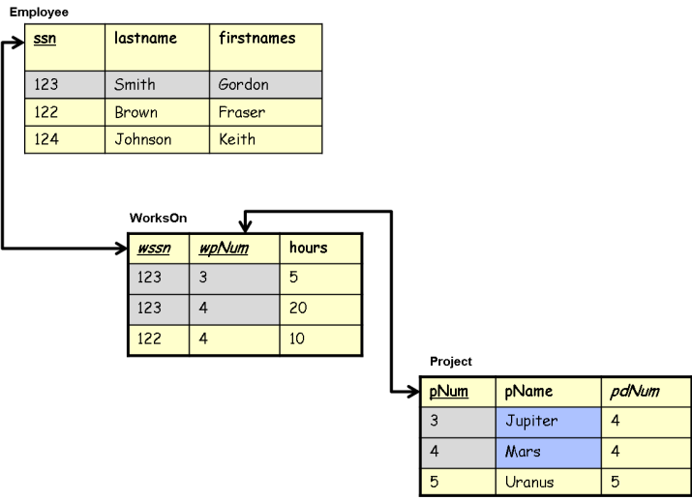
Multi-table S-P-J
Joins data from more than two tables
Example: Find the names of projects that Gordon Smith works on
SELECT P.pName FROM DBEmployee AS E, DBProject AS P, DBWorksOn AS W WHERE E.ssn = W.wssn AND P.pNum = W.wpNum AND E.lastName = 'Smith’ AND E.firstNames = 'Gordon';
Notes:
Harder to write as INNER JOIN

Slide 35
Set Operations
Notes:
SQL supports union, intersection, and set difference (MINUS)
MySQL only supports union

Slide 36
UNION Operator
Combines results from two or more select queries
All of A and B
UNION Removes duplicates
SELECT clause
Same number of columns
Need not have the same name
Must have similar type
Example
List supervisor and manager ssns
SELECT supssn FROM DBEmployee UNION SELECT mgrSsn FROM DBDepartment;
SELECT supssn FROM DBEmployee UNION ALL SELECT mgrSsn FROM DBDepartment;
A
B
Notes:
Duplicates remain in UNION ALL

Slide 37
Intersection
Overlap of A and B
Shaded area
Things that are both A and B
Not supported in MySQL
Same restrictions on select clause
Example
List ssns of employees who are both a supervisor and a manager
SELECT supssn FROM DBEmployee INTERSECT SELECT mgrSsn FROM DBDepartment;
A
B
Notes:
Achieved with subquery

Slide 38
Except
Items of A that are not in B
Yellow area
Not supported in MySQL
Same restrictions on select clause
Example
Find supervisors who are not managers
SELECT supssn FROM DBEmployee EXCEPT SELECT mgrSsn FROM DBDepartment;
A
B
Notes:
Achieved with subquery in MySQL

Slide 39
Nested Queries

Slide 40
Multi-table S-P-J (Revisited)
Example
Find the names of projects that Gordon Smith works on
SELECT P.pName FROM DBEmployee AS E, DBProject AS P, DBWorksOn AS W WHERE E.ssn = W.wssn AND P.pNum = W.wpNum AND E.lastName = 'Smith’ AND E.firstNames = 'Gordon';

Slide 41
SUBQUERY
--it runs the subquery and uses the result in the main query to return the results
SELECT * FROM test_table1
WHERE speed >= (SELECT max(roadspeed) FROM test_table2);
(SELECT max(roadspeed) FROM test_table2);
(30) ;

Slide 42
Nested Query using IN
Example
Find the names of projects that Gordon Smith works on
SELECT pName FROM DBProject WHERE pNum IN (SELECT wpNum FROM DBEmployee AS E, DBWorksOn AS W WHERE E.ssn = W.wssn AND E.lastName = 'Smith’ AND E.firstNames = 'Gordon');

Slide 43
Nested Queries
Enable query optimiser to provide more efficient plans
Subquery can be shared across queries
Subquery can exploit declared views
Easier to understand the query

Slide 44
Nested Query using NOT IN
Example
Find the names of projects that Gordon Smith does not work on
SELECT P.pName FROM DBEmployee AS E, DBProject AS P, DBWorksOn AS W WHERE E.ssn = W.wssn AND P.pNum = W.wpNum AND E.lastName <> 'Smith’ AND E.firstNames <> 'Gordon';
Returns wrong answer! Why?
Notes:
Answer includes projects on which Gordon Smith works on.
These are included as other members of staff work on them.

Slide 45
Nested Query using NOT IN
Example
Find the names of projects that Gordon Smith does not work on
SELECT pName FROM DBProject WHERE pNum NOT IN (SELECT wpNum FROM DBEmployee AS E, DBWorksOn AS W WHERE E.ssn = W.wssn AND E.lastName = 'Smith' AND E.firstNames = 'Gordon');

Slide 46
Existence testing
Depends on subquery returning rows
Not interested in their values
Can be rewritten as a JOIN
Can reference outer query attributes in inner query
Not the other way around
Example
Find the names of all projects with deadlines
SELECT P.pName FROM DBProject AS P WHERE EXISTS (SELECT * FROM DBDeadline AS D WHERE P.pNum = D.projPNum);

Slide 47
NOT EXISTS
Often more useful than existence testing
Example
Find the names of all projects without deadlines
SELECT P.pName FROM DBProject AS P WHERE NOT EXISTS (SELECT * FROM DBDeadline AS D WHERE P.pNum = D.projPNum);

Slide 48
Except using NOT EXIST
Set difference achieved with NOT EXISTS
Find As that are not Bs
Yellow area
Example
Find supervisors who are not managers
SELECT DISTINCT supssn FROM DBEmployee WHERE NOT EXISTS (SELECT mgrssn FROM DBDepartment WHERE mgrssn = supssn);
A
B
Notes:
Achieved with subquery

Slide 49
Aggregate Functions

Slide 50
Aggregate Functions
Compute function over group of values
Functions include
COUNT: number of elements in group
SUM: total of values
AVG: average of values
MIN: minimum value
MAX: maximum value
Examples
What is the average salary?
SELECT AVG(salary) FROM DBEmployee;
What is the largest salary?
SELECT MAX(salary) FROM DBEmployee;
What is the wage bill?
SELECT SUM(salary) FROM DBEmployee;

Slide 51
Grouping data
Data can be clustered into groups
Values may appear in more than one group
SELECT clause can only include
Attributes in GROUP BY clause
Aggregate functions
Example
Number of projects in each department
SELECT pdNum, COUNT(*) AS NumberOfProjects FROM DBProject GROUP BY pdNum;
Notes:
Using an attribute from a non-Group by clause will result in the values of the first group member being used.

Slide 52
Nested Aggregation
Example
Average number of projects in a department
SELECT AVG (numProj) FROM (SELECT COUNT(*) numProj, pdNum FROM DBProject GROUP BY pdNum) AS C;
Notes:
FROM clause does not have to be a table
Need to declare an alias for the nested query

Slide 53
Restrictions on Groups: HAVING
HAVING clause enables filters on groups
Similar to WHERE clause filters but for the group
Can be used in conjunction with WHERE clause
Only applied to
Attributes in group by clause
Aggregate functions
Example
Average salary of departments with more than two female workers
SELECT empdNum, AVG(salary), COUNT(*) FROM DBEmployee WHERE gender = 'F’ GROUP BY empdNum HAVING COUNT(*) > 2

Slide 54
GROUP BY
gardenbirds
Aggregate functions such as :
Count Avg Mean Min Max Sum
type number _____ day____
swift 2 Monday
robin 2 Monday
swallow 2 Tuesday
robin 1 Tuesday
thrush 3 Tuesday
SELECT day, COUNT(*) FROM gardenbirds GROUP BY day;
Monday,2 --- in other words there are 2 records on Monday
Tuesday,3 --- and 3 records from Tuesday
SELECT day, COUNT(*), SUM(number) FROM gardenbirds GROUP BY day;
Monday,2,4 -- the SUM is adding up the number column per group
Tuesday,3,6

Slide 55
gardenbirds
type number _____ day____
swift 2 Monday
robin 2 Monday
swallow 2 Tuesday
robin 1 Tuesday
thrush 3 Tuesday
Aggregate functions such as :
Count Avg Mean Min Max Sum
SELECT day, type, COUNT(*) FROM gardenbirds GROUP BY day;
MONDAY
TUESDAY
2 swift
2 swallow
Will this work?
You can count the items in each ‘bin’
You can sum the total birds in each ‘bin’
But you can’t give each bin a unique ‘type’
1 robin
2 robin
3 thrush
Notes:
It won’t work.. As each GROUP has more than 1 TYPE when Grouped By day --- so it’s not possible to return a summary of a list of types.

Slide 56
GROUP BY
You can GROUP BY multiple fields
The order of group by fields does not matter
SELECT field1, field2
FROM table
GROUP BY field1,field2;

Slide 57
ORDER BY
You can sort the output by column order or multiple columns… this can be used in conjunction with LIMIT to get the top N and last N records.
By default it will be ASCending order (1,2,3…)
You can specify DESCending order (99,98,97..)
SELECT * from mytable ORDER BY value LIMIT 3;
SELECT * from mytable ORDER BY value DESC LIMIT 3;

Slide 58
ORDER of EXECUTION (main items)
FROM – Includes JOINs so consider using a CTE or subquery to do filtering first.
WHERE - To limit the joined dataset.
GROUP BY – Collapses fields down with aggregate functions (COUNT, MAX, SUM, AVG)
HAVING - Performs the same function as the WHERE clause with aggregate values.
SELECT - Specifies values and aggregations remaining in the set after grouping.
ORDER BY – Returns the table sorted by a column or multiple columns. LIMIT – Specifies how many rows to be returned to avoid returning too much data.
https://dev.to/helenanders26/five-sql-tips-2hb
Notes:
This is the order that the RDBMS will actually execute the SELECT statement – explains why most databases you can’t use the aliases from the select in the where part etc
mySQL does some odd tricks though..

Slide 59
Summary
Queries have the form
SELECT column list, aggregate functions FROM table list, subqueries WHERE row restrictions and join conditions connected with AND and OR GROUP BY column list HAVING group restrictions ORDER BY column list LIMIT return a subset of the answer
Notes:
SQL is awesome video to show…

